Slide 1
Cadre: Democratizing Private investments
By: Borna Vahabzadeh

Slide 2
Overview and Origin
Cadre is an online marketplace that connects investors and operators of real estate.
Cadre was started in New York City in 2014
Founders are:
Ryan Williams - Harvard graduate who went on to Goldman Sachs and Blackstone before Cadre
Joshua Kushner - Williams’ classmate who went on to found venture capital firm, Thrive Capital
Jared Kushner - CEO of Kushner Companies (real estate development)

Slide 3
Overview and Origin
Cadre is built on the idea that commercial real estate should be accessible. It allows investors to invest directly in large properties.
Benefits of Cadre:
Diversification and tax benefits
Higher returns than the S&P 500
Fast transaction times
Lower fees and access to data across markets
Cadre funding and backers:
Cadre has received $165mm of capital
Firms: Goldman Sachs, Founders Fund, Ford Foundation, SL Green, Khosla Ventures, Andreessen Horowitz
Private stakeholders: Jack Ma, Mark Cuban, George Soros, Michael Fascitelli

Slide 4
Business Activities
At its core, Cadre is an online marketplace that gives accredited investors the opportunity to invest directly in commercial real estate.
Benefits of investing with Cadre are:
Fast transaction times
Lower fees
Secondary marketplace (liquidity)
Access to data (historically unavailable)
Low investment minimums $50k
Cadre is open to accredited investors who are:
Family offices
Institutional Investors
Wealth managers
High-net-worth-individuals

Slide 5
Business Activities
Cadre’s edge comes from data driven decision making. They analyze over 100+ data sources, track over 1+ million assets, and 900 submarkets. This allows to execute deals quickly.
The online crowdfunding platform makes it easier for investors to invest in CRE
Having a secondary marketplace means that investors can exit their positions at any time after a year, creating liquidity in an asset class that is illiquid
Will provide other alternative assets in the future such as infrastructure, farmland, timber, and energy

Slide 6

Landcape
Commercial real estate is notoriously slow moving and opaque
It is ready for disruption
Lots of middlemen
Inaccessible to most
Where FinTech means real estate
Crowdfunding
Co-working spaces
Streamlining processes
Portfolio management
eREITS and online investing

Slide 7
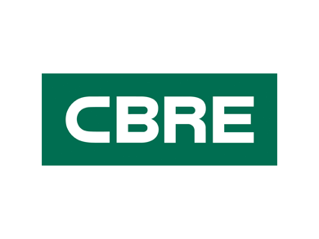
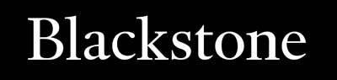
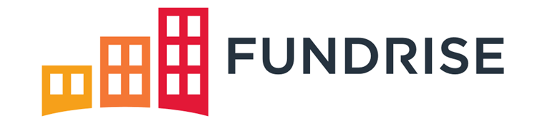
Landcape
Competitors within FinTech
Fundrise
Crowdstreet
RealtyMogul
Peerstreet
Competitors outside of FinTech
REITs
Private Equity
Brokerages

Slide 8
Results
Cadre has raised more than 2x capital than any other competitor in the real estate crowdfunding domain
Closed $1.5+ billion of real estate transactions vs $2.5 billion by fundrise and $2 billion by RealtyMogul
Target IRR of 10-15%+. Fundrise has an annual average return of 10.79% over the past 5 years and crowdstreet has an average IRR of 25.5%
Cadre will start offering other alternative assets which presents an opportunity for growth

Slide 9
Recommendations
Offer investments with more aggressive returns
Implement other alternative assets
Utilize brokerage designation and data analytics to offer undervalued properties
Allow peer to peer transactions
Expand beyond accredited investors

Slide 10
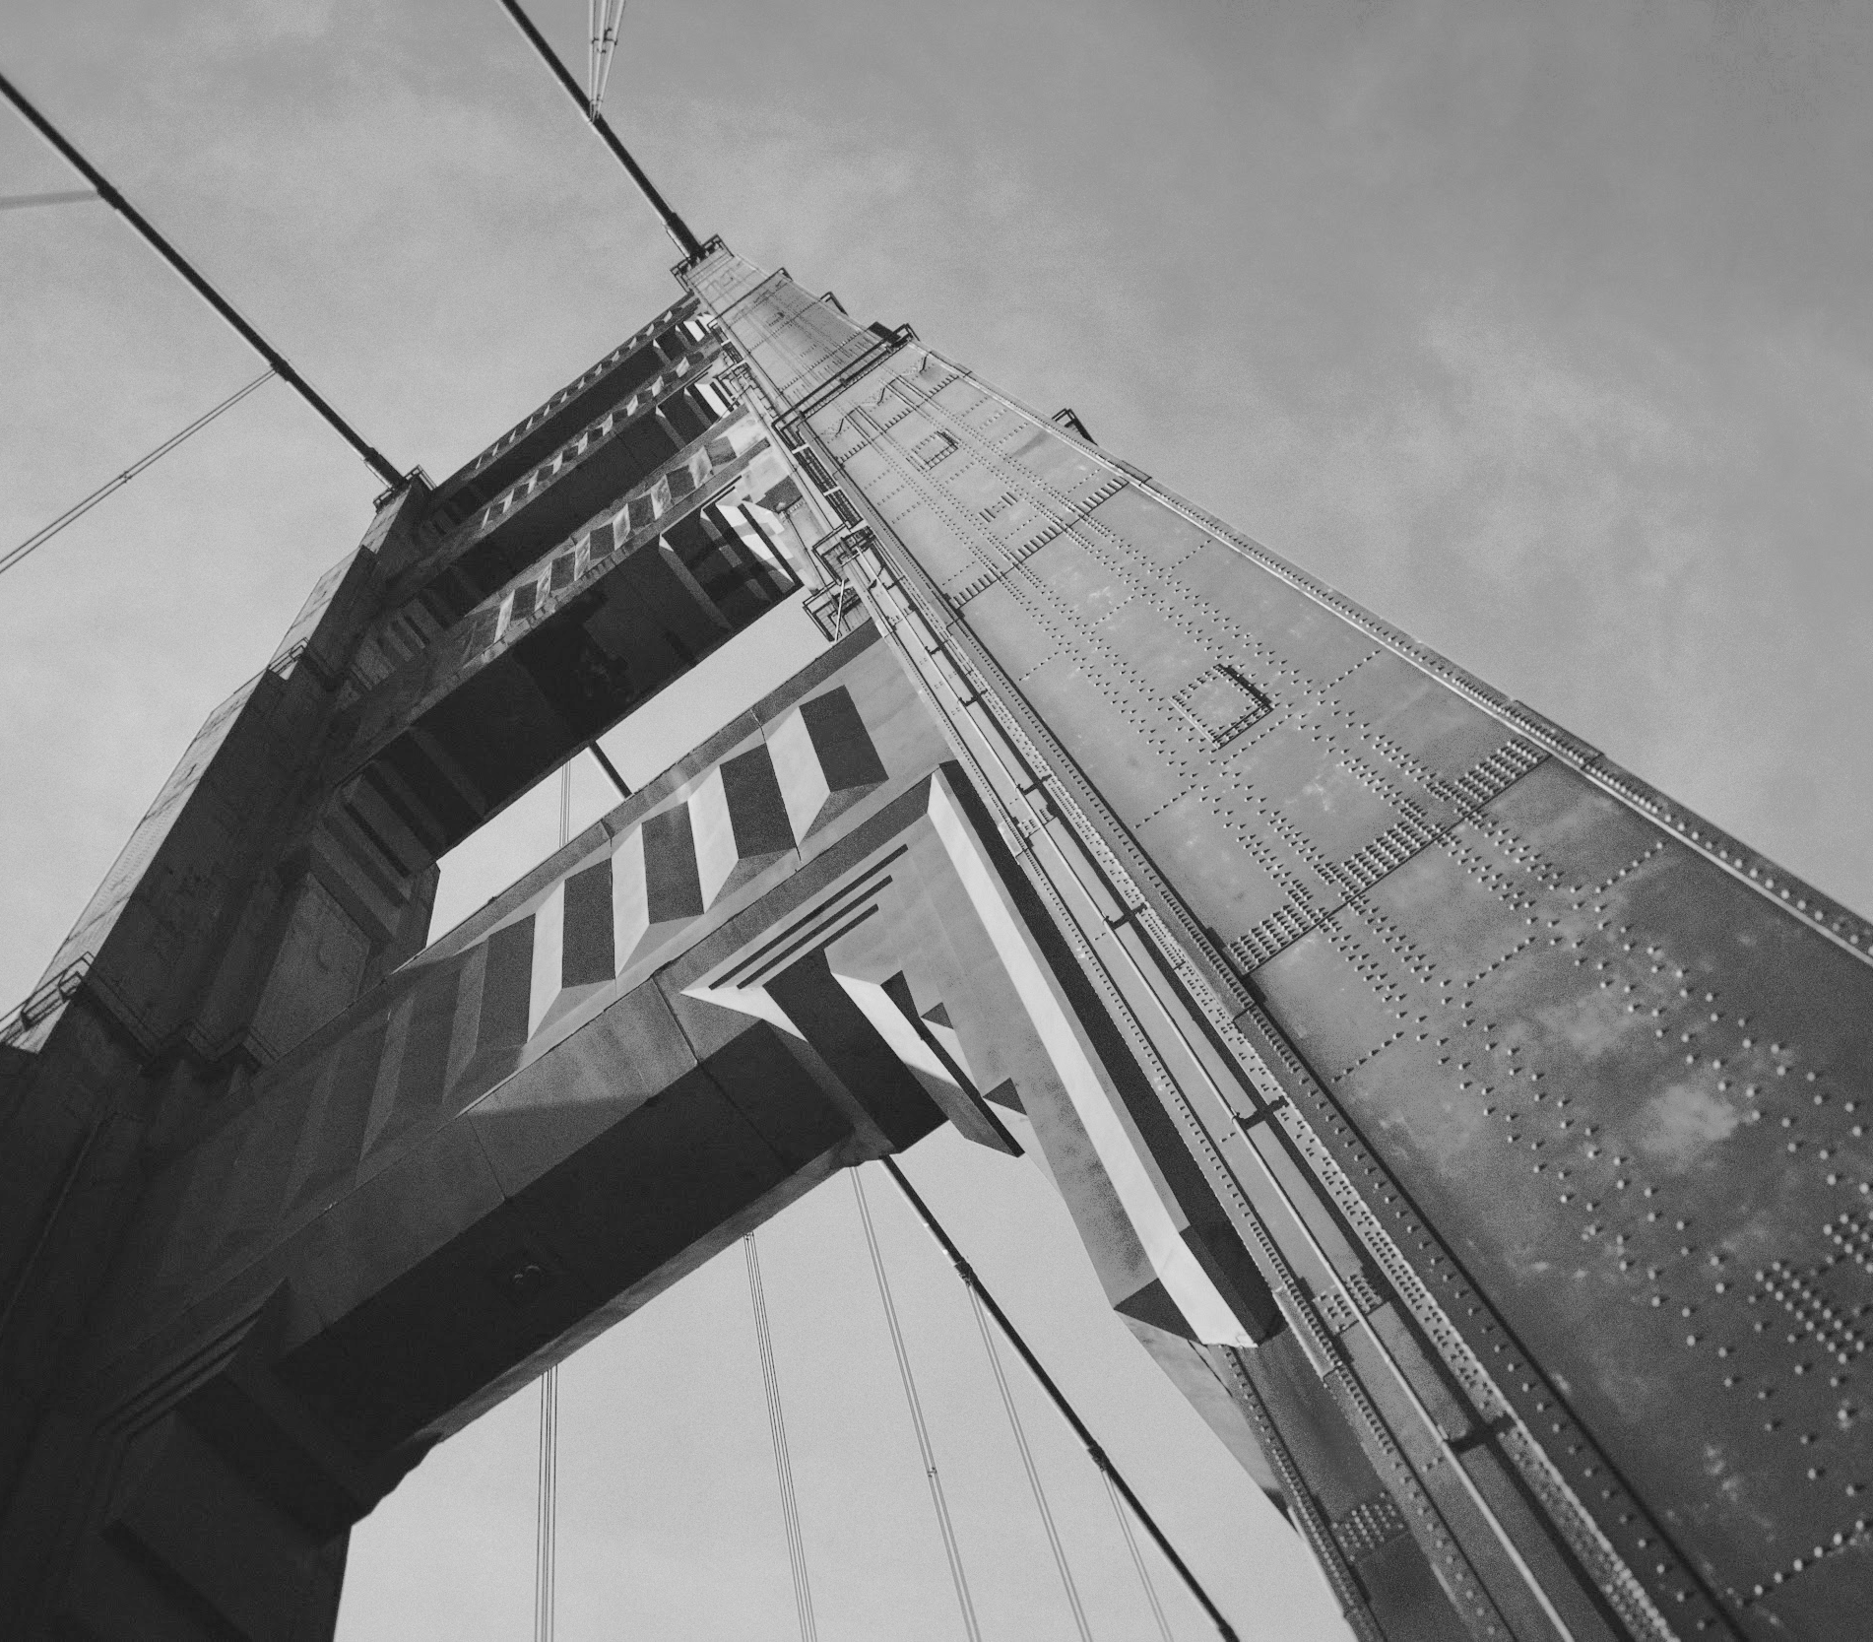
Thanks!

